Slide 1

Bayesian Thurstonian models for ranking data using JAGS by Timothy R. Johnson & Kristine M. Kuhn Behavioral Research (2013) 45:857–872
Presented by: Xiaoming Ji
University of Illinois at Urbana-Champaign

Slide 2
Research Topics
Use JAGS to implement Thurstonian ranking model
Example: Relationship between ranking of compensation plans and cultural orientation
Example: Ranking of job candidates after revelation of résumé discrepancies
Author: Timothy R. Johnson & Kristine M. Kuhn
Published: Behavioral Research (2013) 45:857–872

Slide 3
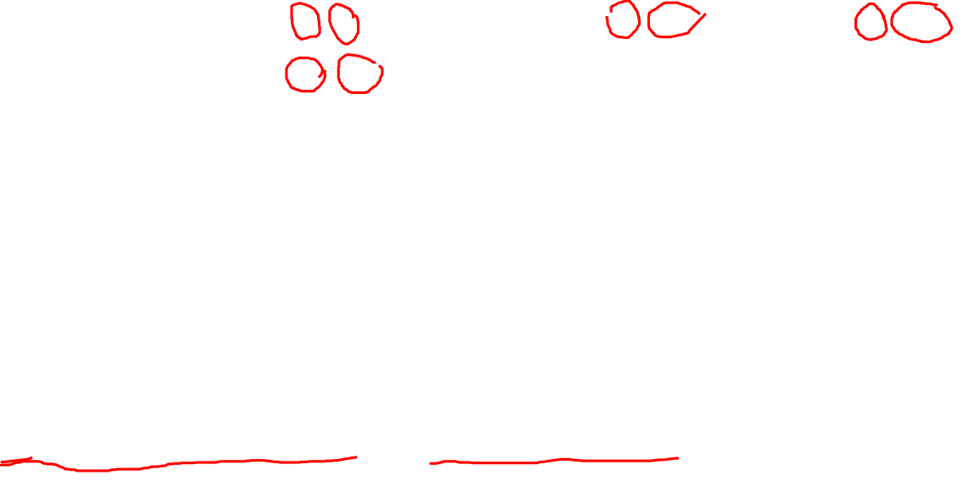
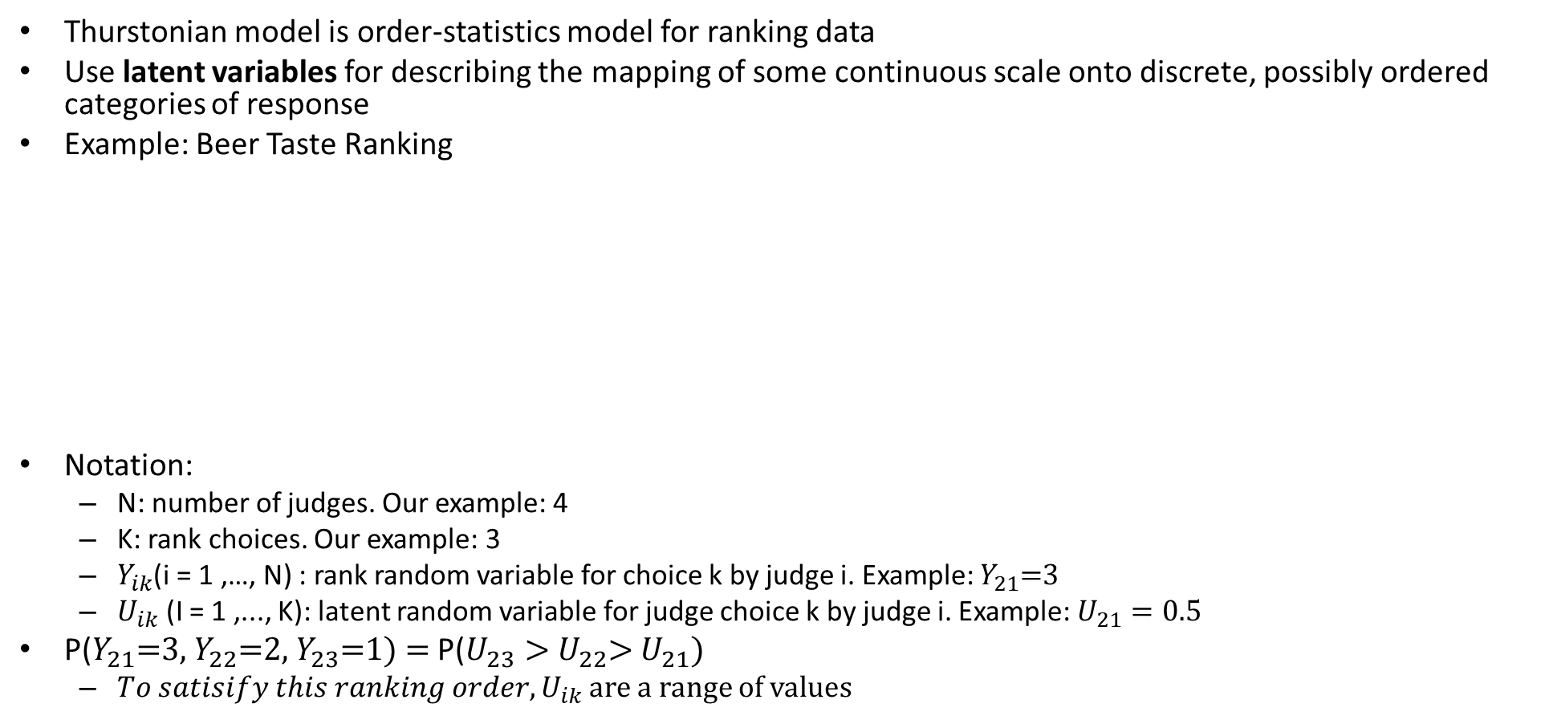
Thurstonian Ranking Model
Thurstonian model is order-statistics model for ranking data
Use latent variables for describing the mapping of some continuous scale onto discrete, possibly ordered categories of response
Example: Beer Taste Ranking
Notation:
N: number of judges. Our example: 4
K: rank choices. Our example: 3
$Y_{ik}$(i = 1 ,…, N) : rank random variable for choice k by judge i. Example: $Y_{21}$=3
$U_{ik}$ (I = 1 ,..., K): latent random variable for judge choice k by judge i. Example: $U_{21}=0.5$
P($Y_{21}$=3, $Y_{22}$=2, $Y_{23}$=1) = P($U_{23}>$ $U_{22}$> $U_{21}$)
$To satisify this ranking order, U_{ik}$ are a range of values
 | Beer 1 (latent value) | Beer 2 | Beer 3
Judge 1 | 1 (1) | 2 (0.5) | 3 (0.2)
Judge 2 | 3 (0.5) | 2 (0.6) | 1 (0.8)
Judge 3 | 3 (0.4) | 1 (0.9) | 2 (0.6)
Judge 4 | 2 (0.7) | 3 (0.6) | 1 (0.8)

Slide 4
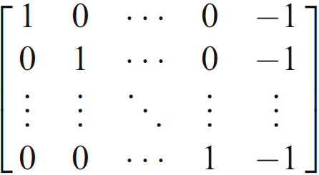
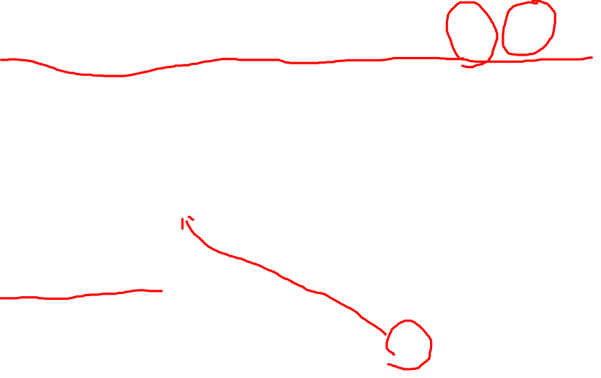
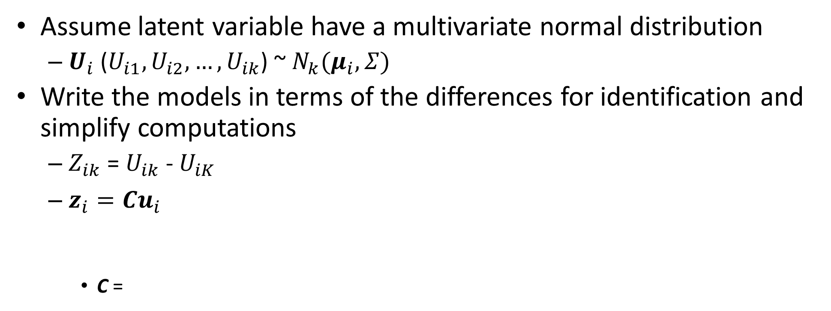
Thurstonian Model Mathematical Description
Assume latent variable have a multivariate normal distribution
$U_{i}$ ($U_{i1},U_{i2},…,U_{ik}$) ~ $N_{k}(μ_{i},Σ)$
Write the models in terms of the differences for identification and simplify computations
$Z_{ik}$ = $U_{ik}$ - $U_{iK}$
$z_{i}=Cu_{i}$
C =

Slide 5
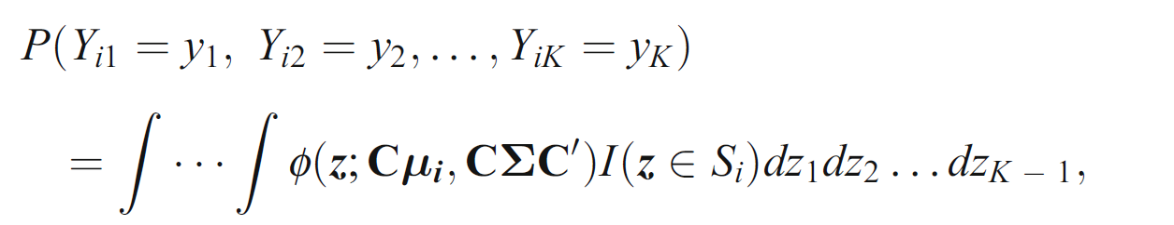
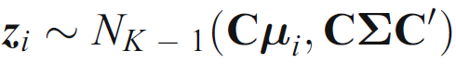
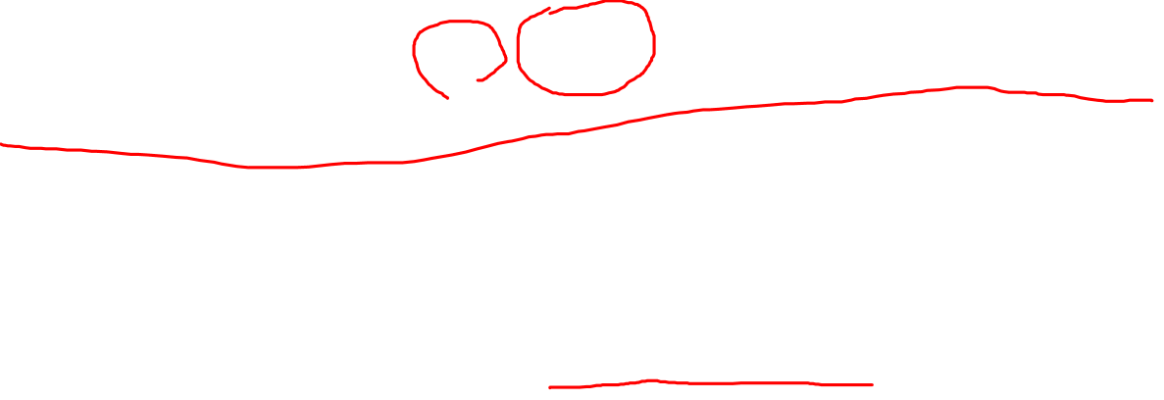
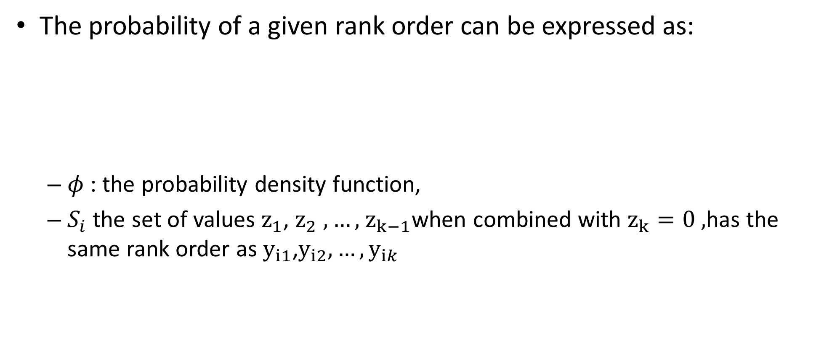
Thurstonian Model Mathematical Description
The probability of a given rank order can be expressed as:
$φ$ : the probability density function,
$S_{i}$ the set of values $z_{1}$, $z_{2} ,…,$ $z_{k−1}$when combined with $z_{k}=0 ,$has the same rank order as $y_{i1}$,$y_{i2},…,y_{ik}$

Slide 6
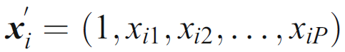
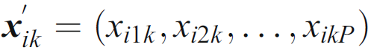
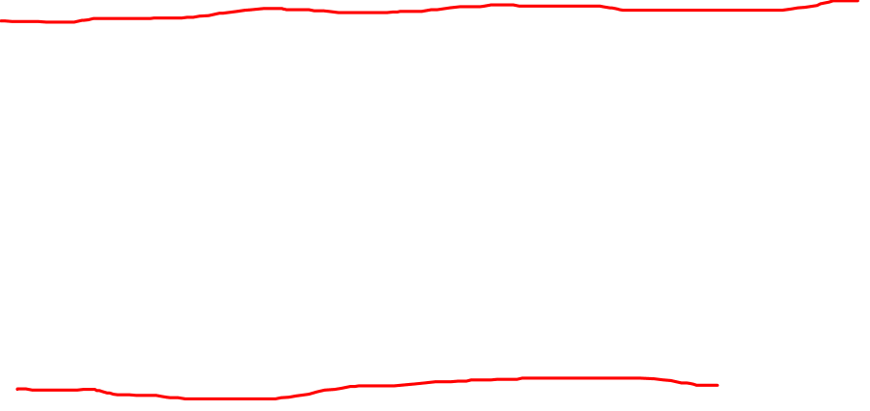
Model Mean${ μ}_{i}$ Using Predictors/Covariates
Predictors represent preference of judges (i.e., male/female, age, drinking preference etc)
Predictors represent the characteristics of the choices (i.e., IPA/Stout/Lager, ABV, IBU)
Notes:
Like generic linear model, the mean can be determined by predictors

Slide 7
Why Use JAGS to Implement Thurstonian Models
Address computational challenges involved
User can easily modify the model to support
other prior distribution
hierarchical linear models
Notes:
The original formula involves multiple integral

Slide 8
Example: Relationship between ranking of compensation plans and cultural orientation
Answer the question: how compensation allocation can be impacted by culture orientation difference between employees
Compensation plans
individual bonus, team bonus, profit sharing, and seniority.
Four cultural value types: horizontal individualism (hi), horizontal collectivism(hc), vertical individualism (vi) and vertical collectivism (vc)
N = 116
K (# of cultural value types) = 4

Slide 9
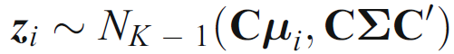
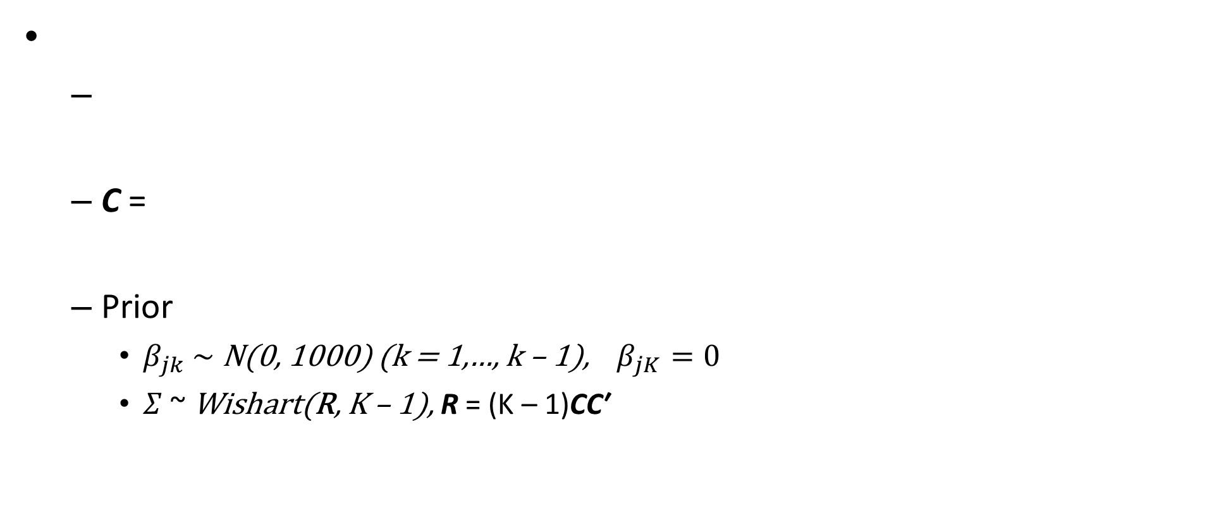
JAGS Model
C =
Prior
$β_{jk} \sim$N(0, 1000) (k = 1,…, k – 1), $β_{jK}=0$
$Σ$ ~ Wishart(R, K – 1), R = (K – 1)CC′

Slide 10
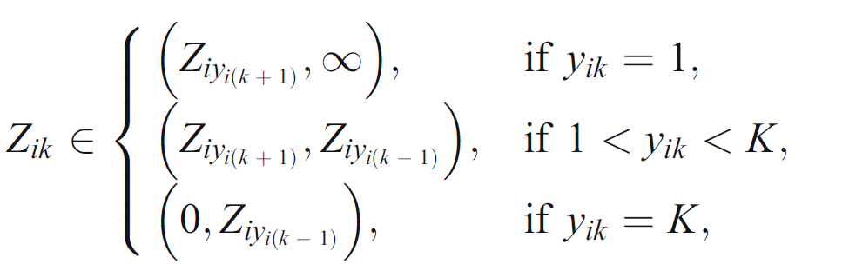
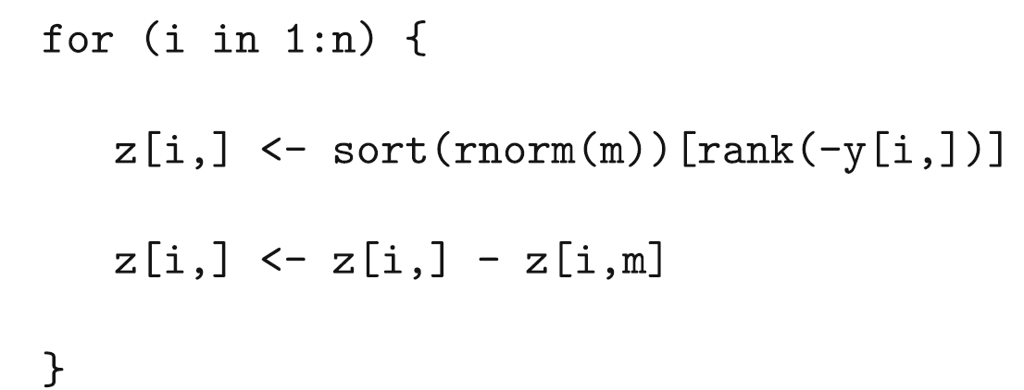
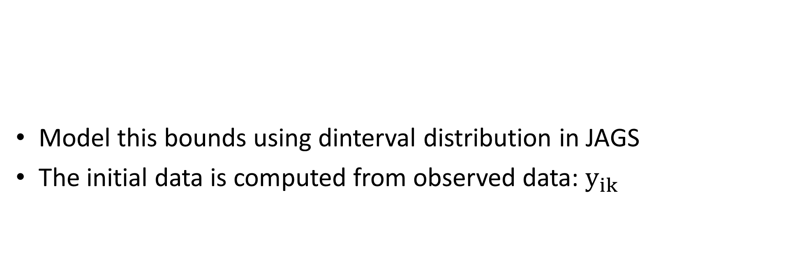
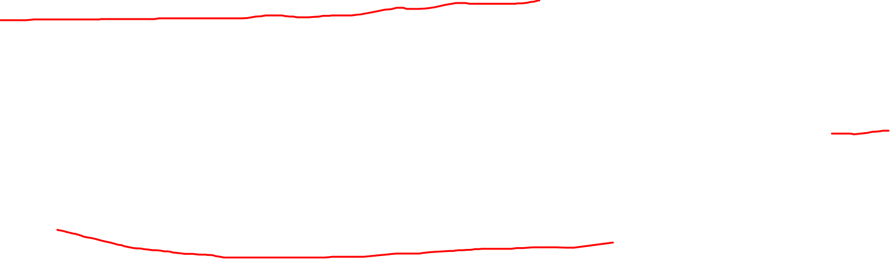
Constraints o$n Z_{ik}$
Model this bounds using dinterval distribution in JAGS
The initial data is computed from observed data: $y_{ik}$

Slide 11
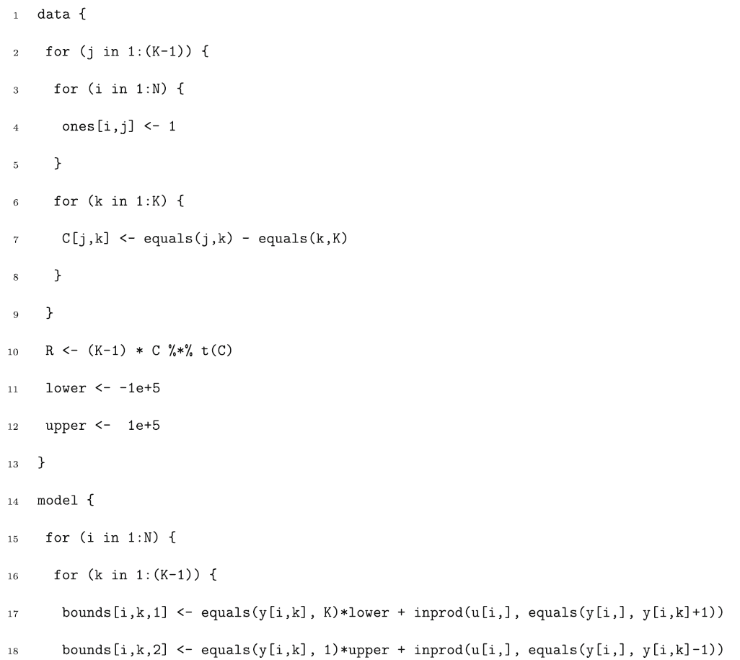
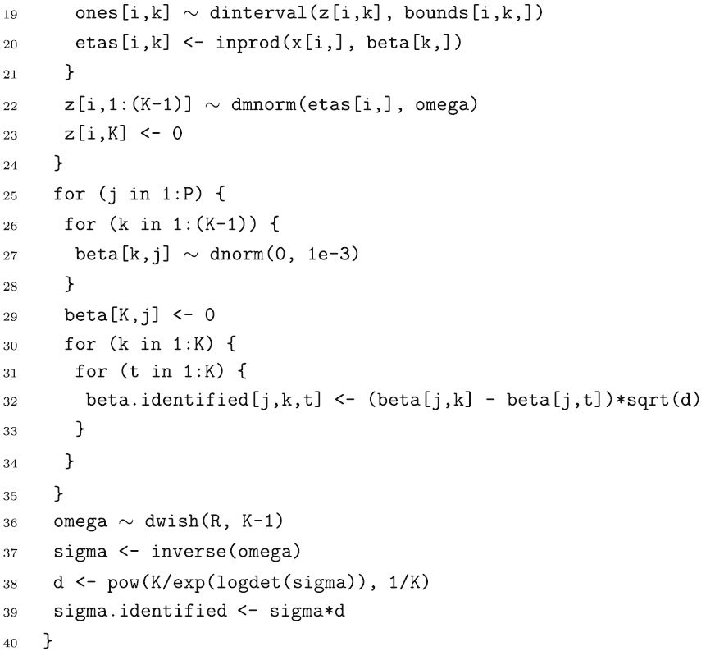
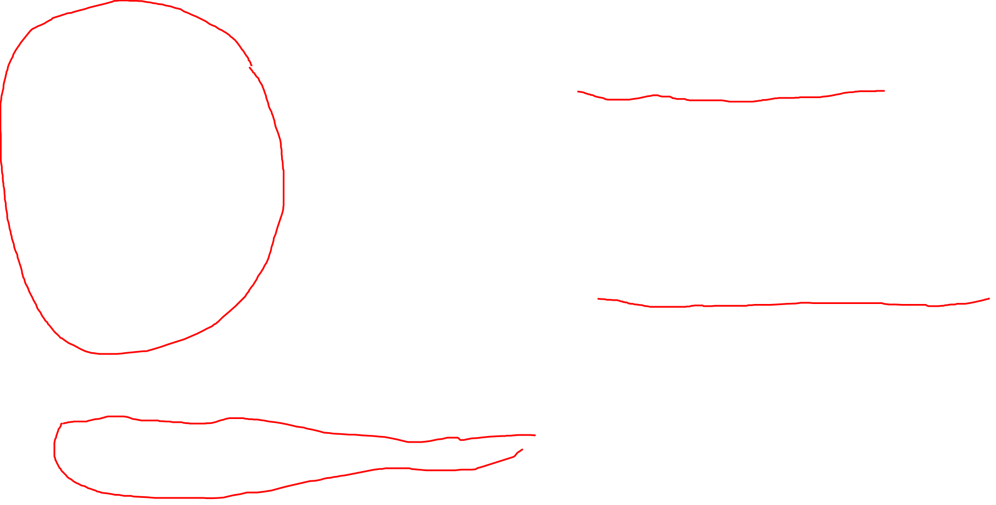
JAGS Model Code

Slide 12
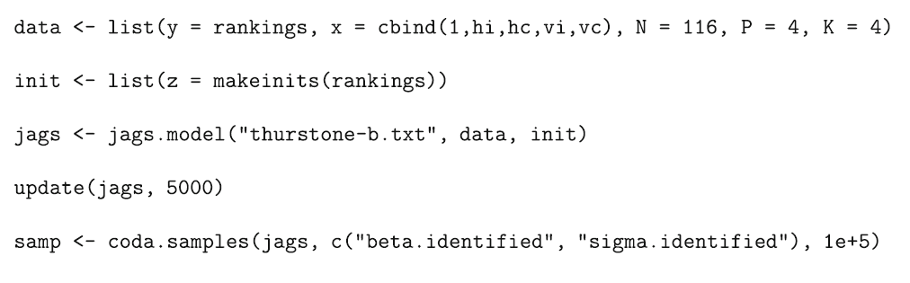
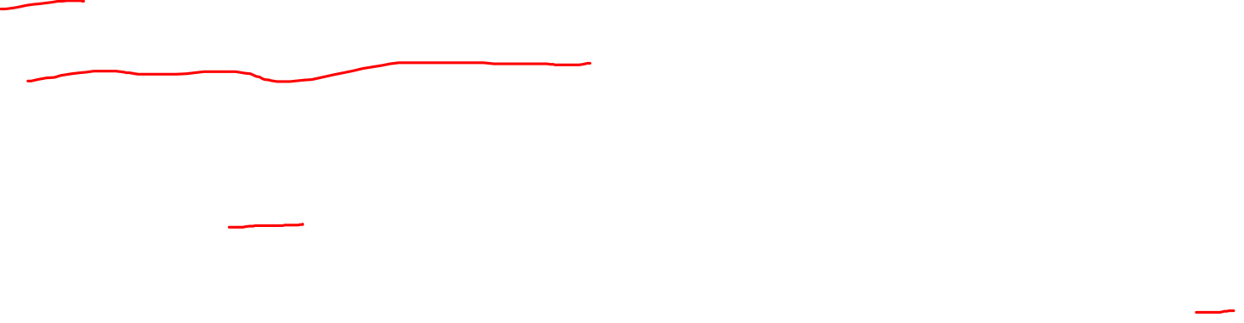
Run JAGS Model

Slide 13
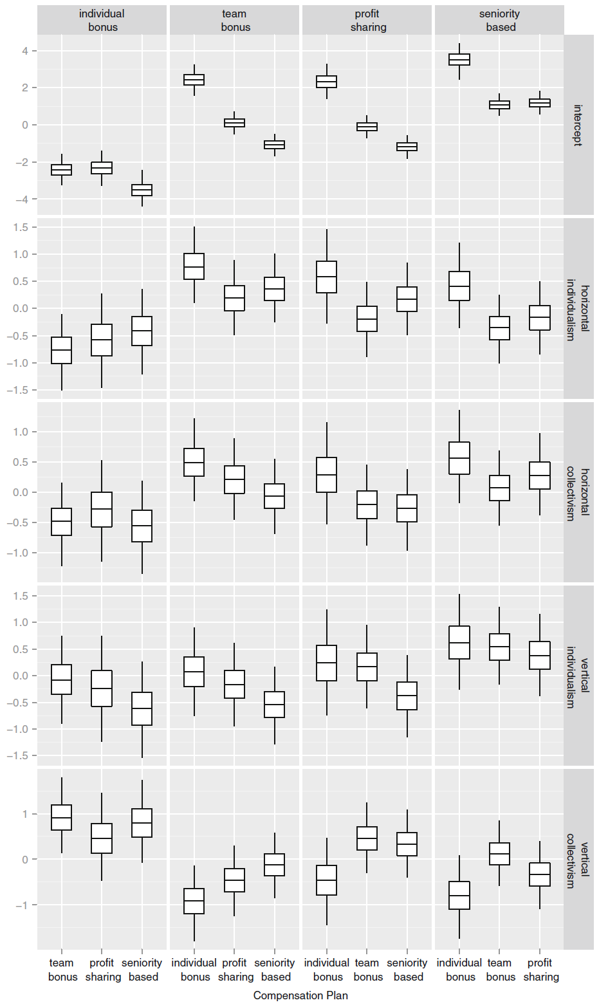
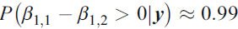
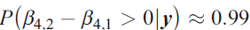
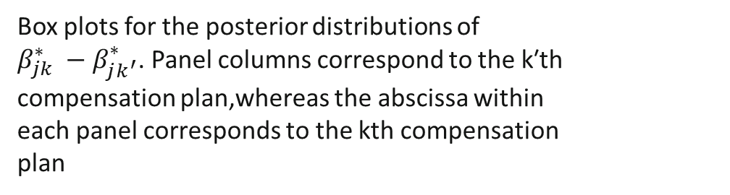
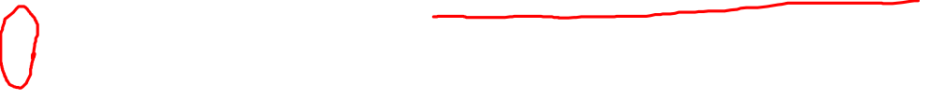
Statistical Results
The posterior probability that the preference for individual versus team bonus increases with horizontal individualism is:
The posterior probability that preference for team bonus versus individual bonus increases with vertical collectivism is:
Box plots for the posterior distributions of
$β_{jk}^{∗} −β_{jk^{′}}^{∗}$. Panel columns correspond to the k′th compensation plan,whereas the abscissa within
each panel corresponds to the kth compensation
plan

Slide 14
Thank You!

